Slide 1

TATA MOTORS LIMITED EOM Assignment III
A presentation by: Ashray Dimri | Riju khatri | Rishabh Drolia Aman chopra | Suvimal yashraj

Slide 2
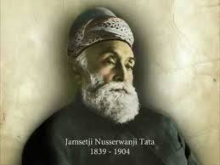
About the company
Founded: 1945
Founder: JRD Tata
Headquarters: Mumbai, India
Chairman : Natarajan Chandrasekaran
Parent: Tata Group
Subsidiaries: Jaguar, Landrover
Products: Automobiles and Engines.
Revenue: Rs: 80,938.85 Crores (2016-17)

Slide 3
Tata motors at a glance
Tata Engineering and Locomotive Company- Renamed Tata Motors in 2003
India’s Largest Automobile manufacturing company
→ Commercial Passenger and Utility vehicles – 59% Market Share
→ Medium and Heavy Commercial Vehicles – Ranked 6th in the world
First Company from India’s engineering sector to be listed in NYSE

Slide 4
Auto manufacturing and assembly Plants in India and abroad
INDIA
Jamshedpur
Pantnagar
Lucknow
Sanand
Dahrwad
Pune
ARGENTINA
SOUTH AFRICA
GREAT BRITAIN
THAILAND

Slide 5
TATA MOTORS LIMIted
VISION
As a high performance organisation by FY2019
Among the top 3 in global CV and domestic PV
Achieving sustainable financial performance
Delivering exciting innovations
MISSION
Innovate mobility solutions with passion to enhance the quality of life

Slide 6
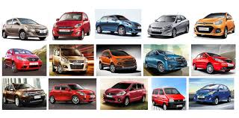
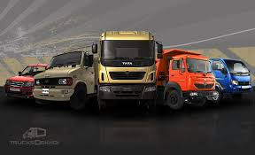

Slide 7
Short term & long term goals
TATA MOTORS LIMITED

Slide 8
Short term goals
Leveraging their Capabilities :They have plans to leverage this broad product base further with their strong brand recognition in India, their understanding of local consumer preferences, well developed in-house engineering capabilities and extensive distribution network.
Reducing Costs and breakeven points: the diesel engine used in their Indica was modified for use in the Ace, which helped to reduce the project cost of the Ace. Similarly, platform sharing for the manufacture of pickup trucks and UVs enables them to reduce capital investment that would otherwise be required while allowing them to improve the utilization levels at their manufacturing facilities .
Enhancing capabilities through the adoption of superior processes: Development of balance score cards (BSC) for measurement based feedback and management. Deployment of a new product introduction (NPI) process for systematic product developement.

Slide 9
Short term goals
Customer Financing : they intend to expand their vehicle financing activities to enhance their vehicle sales
Continuing to invest in technology and technical skills: Their research and development resources, which include those at their subsidiaries, like TMETC, TDCV, TTL and Hispano together with the two advanced engineering and design centres of Jaguar Land Rover they recently acquired, further increase their capabilities in product design, manufacturing and quality control

Slide 10
LONG term goals
Maintaining financial strength : Their cash flow from operating activities in fiscal 2015 and 2014 was Rs. 35,194 million and Rs. 33,114 million respectively. Their net income declined in fiscal 2015, due to sudden and significant deterioration of the world economy, resulting in a significant decline in sales volumes, which affected their income and operating cash flow.
Leveraging Brand equity : . The Tata brand is used and its benefits are leveraged by Tata Companies to their mutual advantage. They recognize the need for enhancing their brand recognition in highly competitive markets in which they compete with internationally recognized brands.
Mitigating Cyclicality: To mitigate the impact of cyclicality in the automobile market, they plan to continue to strengthen their operations through significant presence across different segments, wide range of products and geographies

Slide 11
LONG term goals
Expanding their International business: through strategic acquisitions and by expanding their product range into select geographies where they have an opportunity to grow in markets with similar characteristics to the Indian market.

Slide 12
Types of plans used
TATA MOTORS LIMITED

Slide 13
Purposes / vision
As a high performance organisation by FY2019.
Among the top 3 in global CV and domestic PV.
Achieving sustainable financial performance.
Delivering exciting innovations.

Slide 14
OBjectives
National Growth
International Growth
Ethical Objectives

Slide 15
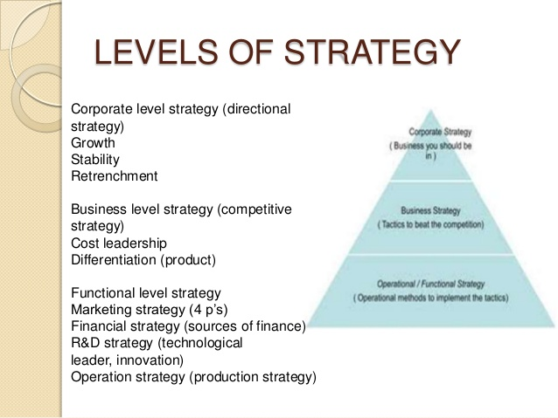
Strategies

Slide 16
POLICIES
Safety and Health Policy
Environmental Policy
Quality Policy
Whistle Blower Policy

Slide 17
Programs
Aarogya- Health
Kaushalya- Wealth by training
Vidyadhanam- Education
Seva- Oppurtuinities
Aadhar- Helping backward castes
Vasundhara- CSR
Amrutdhara- Drinking Water

Slide 18
Characteristics of an organisational plan
Tata motors limited

Slide 19
Characteristics of an organisational plan
Effective sharing of goals
Teamwork
High employee morale
Offers training opportunities
Leadership
Handles poor performance
Understanding Risks
Adapts to opportunities and changes
Clearly defined Structure
Well known company policies

Slide 20
SWOT analysis & bcg matrix
Tata motors limited

Slide 21
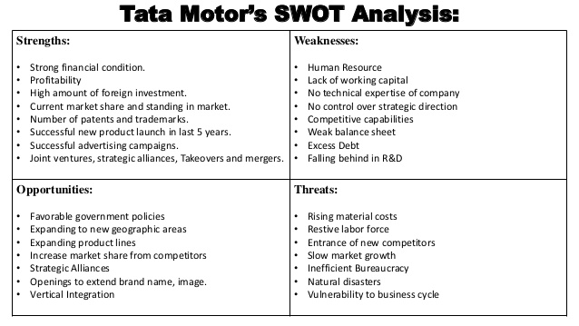
Swot analysis

Slide 22
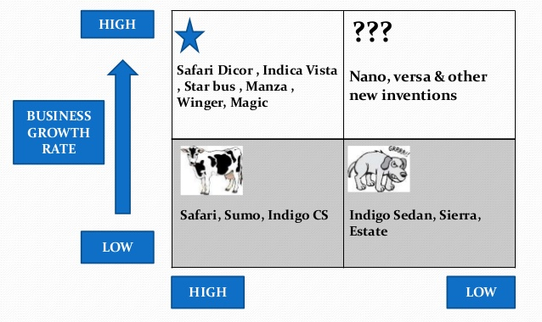
BCG MATRIX

Slide 23
Organisational structure
Tata motors limited

Slide 24
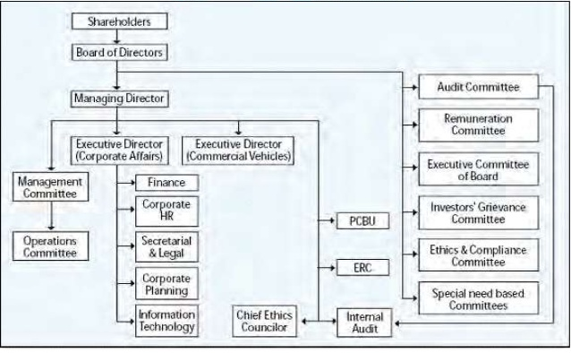
Organisational Structure

Slide 25
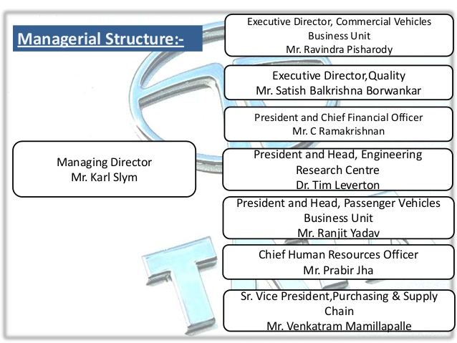
Managerial structure

Slide 26
Leadership style and decision making
Tata motors limited

Slide 27
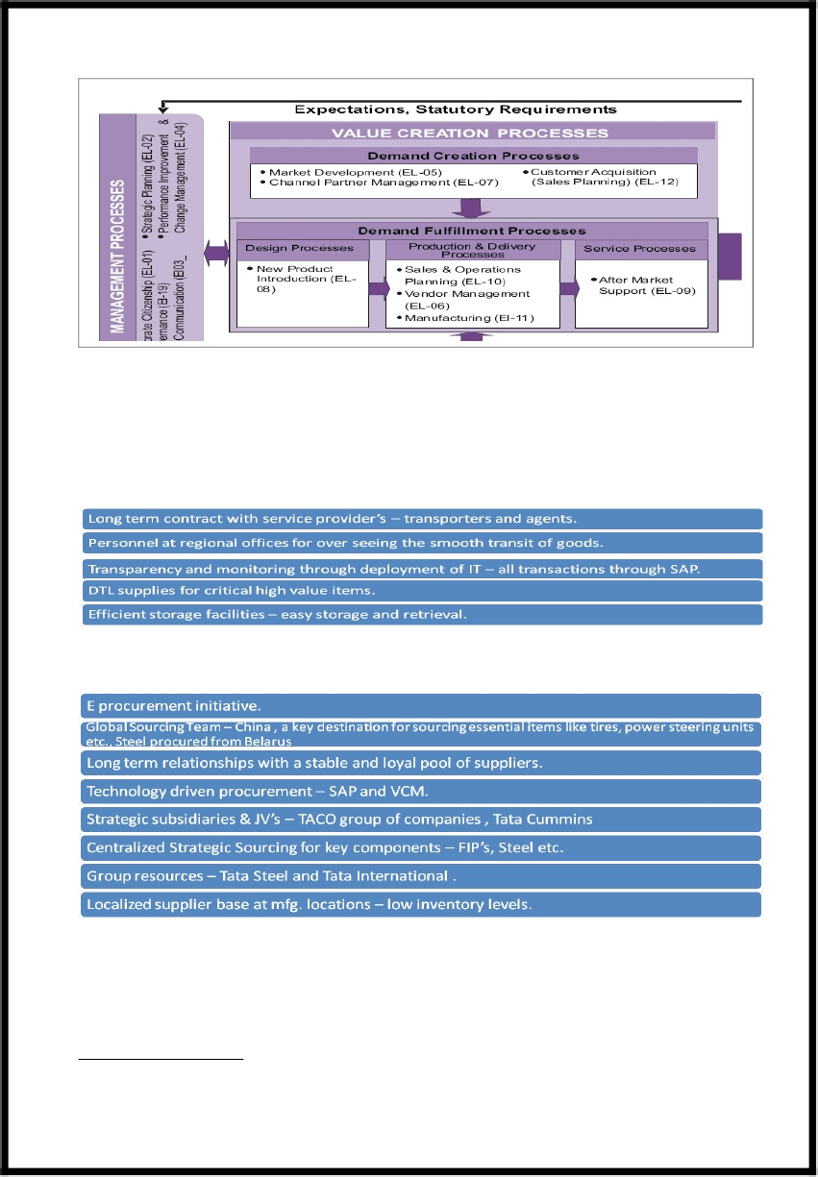
Enterprise process model

Slide 28
Enterprise process model
When Tata Motors made a huge loss of 500 crores in the year 2000-01, analysts had all but written off Tata Motors fortunes. But TML was determined to bounce back and hence started the process of serious introspection. Three key reasons were identified for the massive loss—
Lack of customer focus
Lack of process management
Lack of new products and variants.
Then TTM introduced Enterprise Process Model in their organisational processes.

Slide 29
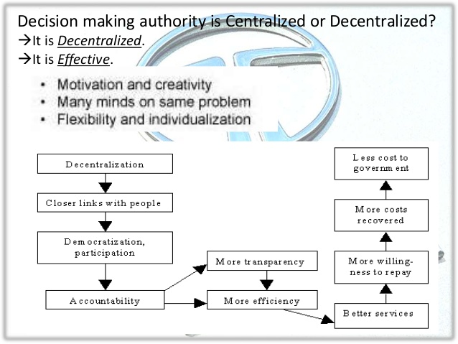
Decision making process @ TTM

Slide 30
If i was the ceo of tata motors
TATa motors limited

Slide 31
Short term and long term goals
Short term goals
Establishing a hold on the mid value segment cars in the local market.
Leverage existing IT and marketing infrastructure of the company to deploy newer marketing campaigns focusing on “Make in India”.
Reduce the cost of manufacturing to provide cost efficient and effective models of cars to the customers also reduce the ultimate breakeven quantity.

Slide 32
Short term and long term goals
Long term goals
To develop and launch tata motor’s first mid value segment electric cars in India.
To open India’s first automotive R&D lab in India.
To shift focus to hybrid cars which contribute the environment and is eco-friendly.

Slide 33
Thank You !

